Slide 1
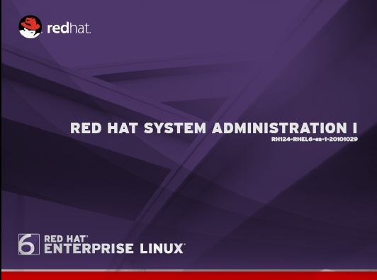
Presented By:-
Mr. Krishna (Director)

Slide 2
KR Network Cloud Tech. Pvt. Ltd.
History Of Linux
History of Unix
What is Open Source
Features of Linux
Open source OS
Red hat flavors
Difference b/w windows & Linux
Type of login users
Type of login mode
Type of Installation Mode
Desktop Environment
Partition Requirement
Linux principles
Linux installation
Outline

Slide 3
KR Network Cloud Tech. Pvt. Ltd.
History Of Linux
Linux is an open source operating system.
Linux kernel is developed by Linus Torvalds in 1991.
Linux is an Unix-based kernel.
Linus Torvalds creates open source, UNIX-like kernel, released under the GPL (General Public License).
At that time Linus Torvalds was a graduate student from Helsinki university.
Written in C & C++ Languages.
Support CLI & GUI modes.

Slide 4
KR Network Cloud Tech. Pvt. Ltd.
History of Unix
Unix is a Command line OS written in the C Programming language.
Started in 1965 by AT & Bell labs.
Created by Dennis Ritchie & Ken Thompson in 1969.
Written in 100% C language and released in 1973.
Support only CLI mode.

Slide 5
Unix Flavors
KR Network Cloud Tech. Pvt. Ltd.
Sun Microsystems
Solaris
IBM
AIX
HP
HP-UX

Slide 6



KR Network Cloud Tech. Pvt. Ltd.
Inventors of Unix & Linux
Dennis Ritchie
Ken Thompson
Linus Torvalds

Slide 7
KR Network Cloud Tech. Pvt. Ltd.
What is Open Source
Software and source code available to all
The freedom to distribute software and source code
The ability to modify and create derived works
Integrity of author’s code

Slide 8
KR Network Cloud Tech. Pvt. Ltd.
Features of Linux
Multi-user
Allow multiple users to login and use the resources
at the same time.
Multi-processing
Allow to performs multiple process at the same time.
Multitasking
Capable of running multiple applications and process
at the same time.

Slide 9
Portabillity
Can be installed on all hardware architecture.
Reliability
Large servers have been successfully being running without
a single second of down time.
Security
Inbuilt firewall (iptables) and SELinux.
Open Source
Free Software along with the source code and documentation.

Slide 10
Open Source
zzzzz
KR Network Cloud Tech. Pvt. Ltd.
Open Source OS
Redhat
Suse
Ubuntu
CentOS
Debian
Slackware
Turbolinux
Puppy linux
BSD ( Bharat operating system solution )
Linux Mandrake

Slide 11
KR Network Cloud Tech. Pvt. Ltd.
RED HAT Flavors
Fedora
RHEL

Slide 12
KR Network Cloud Tech. Pvt. Ltd.
Difference b/w Windows & Linux
Linux | Windows
Open Source Development Model and so the programmer can redesign the OS. | It is not an open source and hence cannot be redesigned by the programmer.
Linux is robust and very much secure from virus. | Windows gets affected by virus very easily.
The Linux servers has surpassed Windows server operating system in security. | Security is the main issue which has made windows to think to survive.

Slide 13
KR Network Cloud Tech. Pvt. Ltd.
Linux | Windows
In Linux File Systems Supported: ext2, ext3,ext4 | In Windows File system Supported: FAT & NTFS
linux us - lilo (linux loader) grub (grand unified bootloader) | windows – NTLDR (new technology loader)
In Linux software file extension is: .rpm (redhat package manager) | In windows software file extension is : .exe
It costs less to design and implement Linux Network | It costs more to implement Windows Network administration, when compared to Linux.
There are 250000+ developers behind Linux for open source deployment. | Compared to Linux,windows is developed by few thousands of people.

Slide 14
KR Network Cloud Tech. Pvt. Ltd.
Type of Login Users
Super Users
Normal Users
Login : root
Password : redhat
Login : krishna
Password : 123
[ root @ krnetworkcloud ~ ] #
[ krishna @ krnetworkcloud ~ ] $

Slide 15
KR Network Cloud Tech. Pvt. Ltd.
Type of Login Mode
CLI
GUI
Command Line interface
Graphical User Interface

Slide 16
KR Network Cloud Tech. Pvt. Ltd.
Type of Console ( In RHEL-5 )
ALT + CTRL + F1 for terminal 1
ALT + CTRL + F2 for terminal 2
ALT + CTRL + F3 for terminal 3
ALT + CTRL + F4 for terminal 4
ALT + CTRL + F5 for terminal 5
ALT + CTRL + F6 for terminal 6
CLI
or
Text
GUI
ALT + CTRL + F7 for terminal 7
Terminal 7 is by default graphic mode beside it all six terminal are CLI based.

Slide 17
KR Network Cloud Tech. Pvt. Ltd.
Type of Console ( In RHEL-6)
GUI
ALT + CTRL + F1 for terminal 1
ALT + CTRL + F2 for terminal 2
ALT + CTRL + F3 for terminal 3
ALT + CTRL + F4 for terminal 4
ALT + CTRL + F5 for terminal 5
ALT + CTRL + F6 for terminal 6
CLI
or
Text

Slide 18
KR Network Cloud Tech. Pvt. Ltd.
Type of Installation Mode
CLI based
GUI based

Slide 19
KR Network Cloud Tech. Pvt. Ltd.
Desktop Environment
GNOME
( Graphical network object model environment)
KDE
(Kedze desktop environment)

Slide 20
KR Network Cloud Tech. Pvt. Ltd.
Linux Principles:-
Everything is a file (including hardware)
Small, single-purpose programs
Ability to chain programs together to perform complex tasks
Avoid captive user interfaces
Configuration data stored in text.

Slide 21
KR Network Cloud Tech. Pvt. Ltd.
Partition Requirement
1- / -- ext2,ext3,or ext4 10G
2- Swap twice of RAM size
3- /boot- ext2,ext3 or ext4 200M
4- /home- ext2,ext3 or ext4 1G

Slide 22
KR Network Cloud Tech. Pvt. Ltd.
Linux Installation

